Slide 1
ENGINEERING ECONOMY
LECTURE 5
PROF.DR. YASEMİN ASU ÇIRPICI, MU, DEPT. OF ECONOMICS

Slide 2
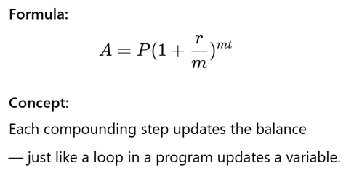
Compound Interest as Iteration

Slide 3
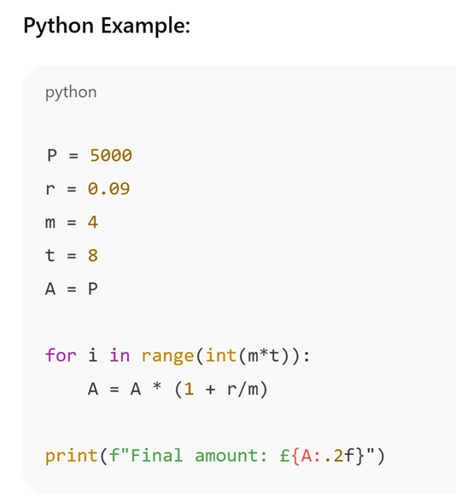
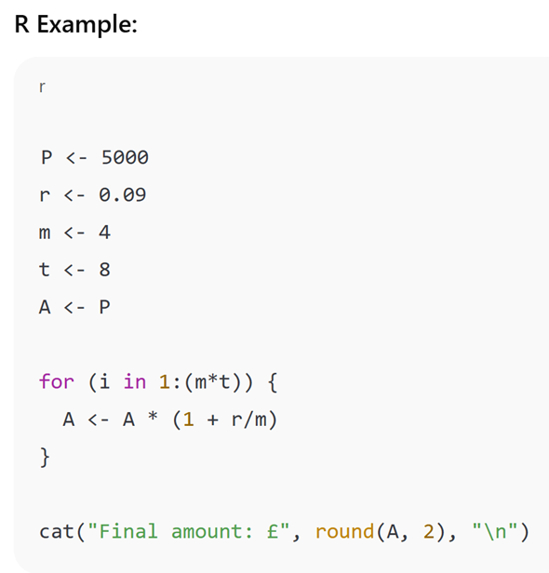
The final amount after 8 years, with ₺5000 compounded quarterly at 9% nominal annual interest, is: ₺10,190.52

Slide 4
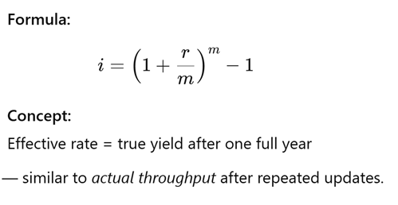
Effective Interest Rate as System Performance
Notes:
Throughput: iş/zaman, üretilen iş

Slide 5
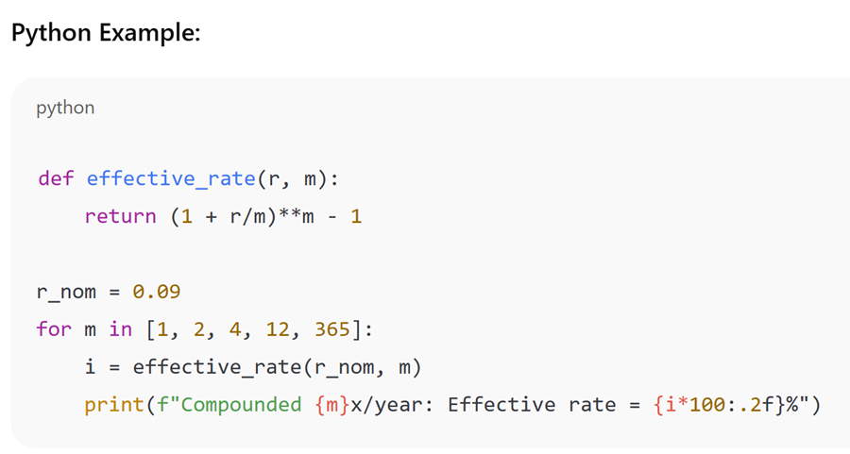

Slide 6
Here are the calculated effective annual rates for each compounding frequency (nominal rate = 9%):
Compounded 1x/year → 9.00%
Compounded 2x/year → 9.20%
Compounded 4x/year → 9.31%
Compounded 12x/year → 9.38%
Compounded 365x/year → 9.42%
As compounding becomes more frequent, the effective rate increases slightly, approaching the continuous compounding limit of about 9.417%

Slide 7
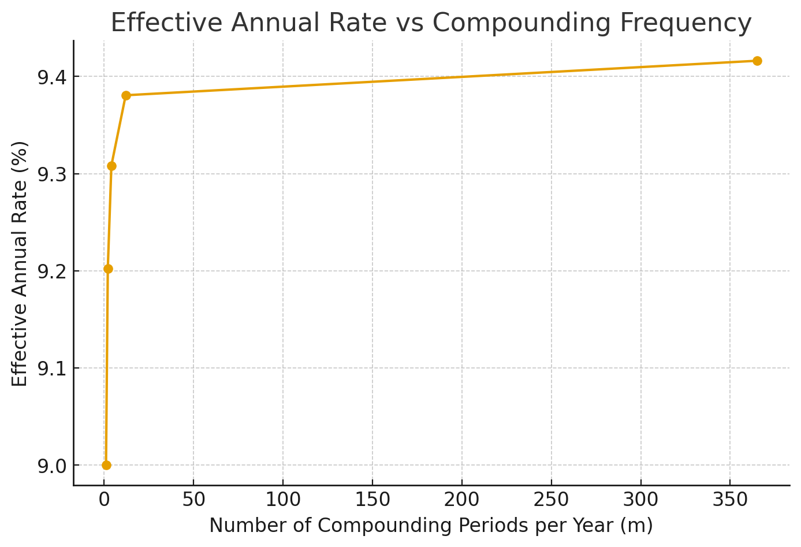
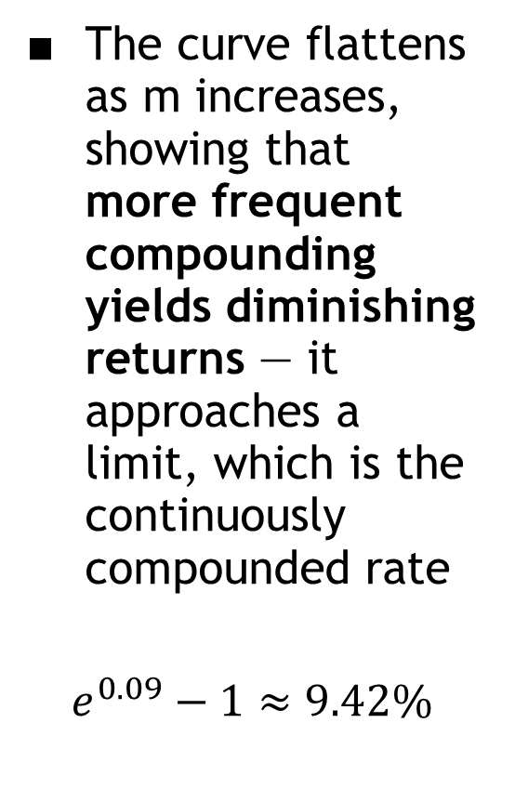
The curve flattens as m increases, showing that more frequent compounding yields diminishing returns — it approaches a limit, which is the continuously compounded rate
$$e^{0.09}−1≈9.42\%$$

Slide 8
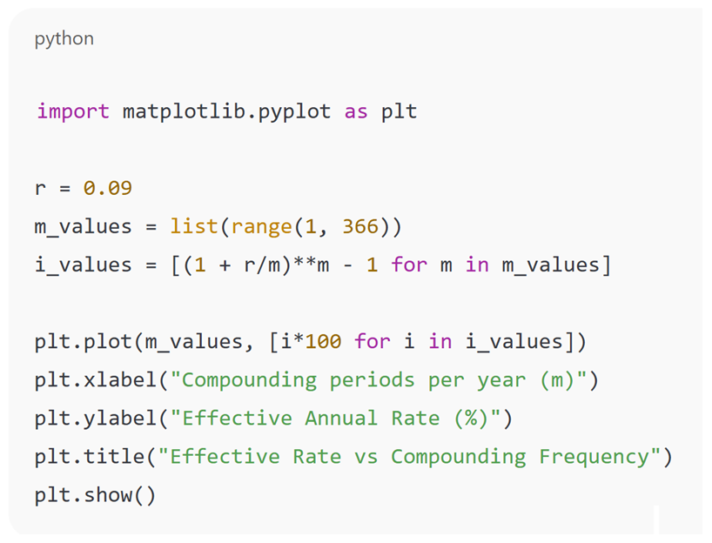
Plot how the effective rate changes as compounding frequency increases.

Slide 9
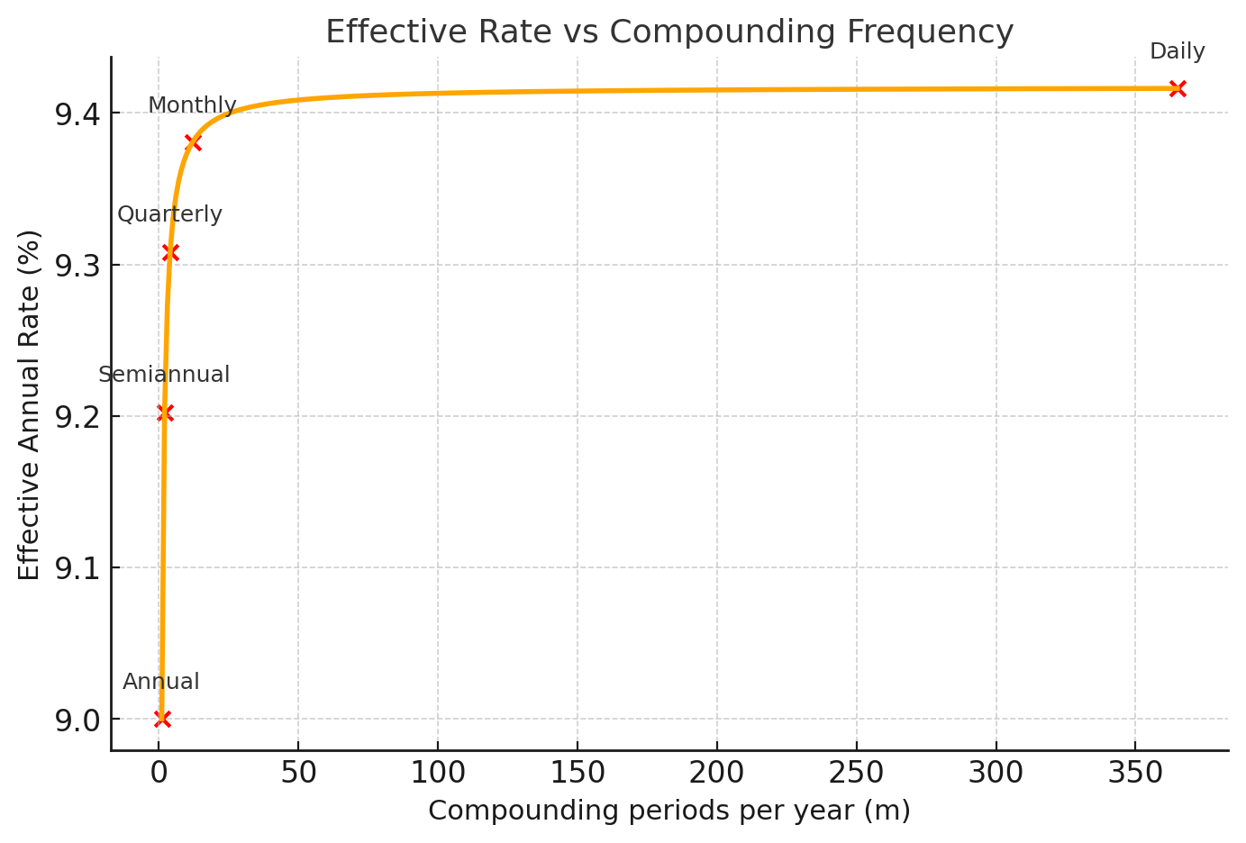
Graph visually shows how increasing compounding frequency — from annual, semiannual, quarterly, monthly, to daily — gradually increases the effective rate, approaching the continuous compounding limit around 9.42%.

Slide 10
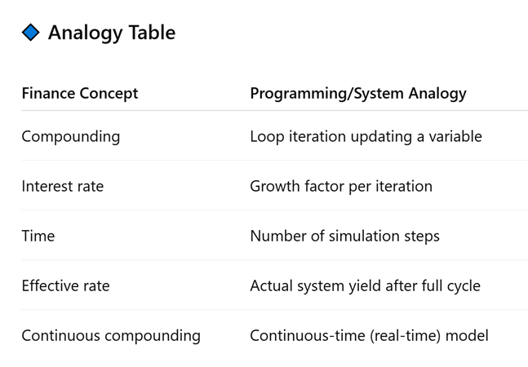

Slide 11
Calculations Involving Uniform Series and Randomly Placed Single Amounts
In most of the equivalence computations, the frequency of cash flows does not equal the frequency of interest compounding.
To correctly perform any equivalence computation, it is essential that the compounding period and payment period be placed on the same time basis, and the interest rate be adjusted accordingly.

Slide 12
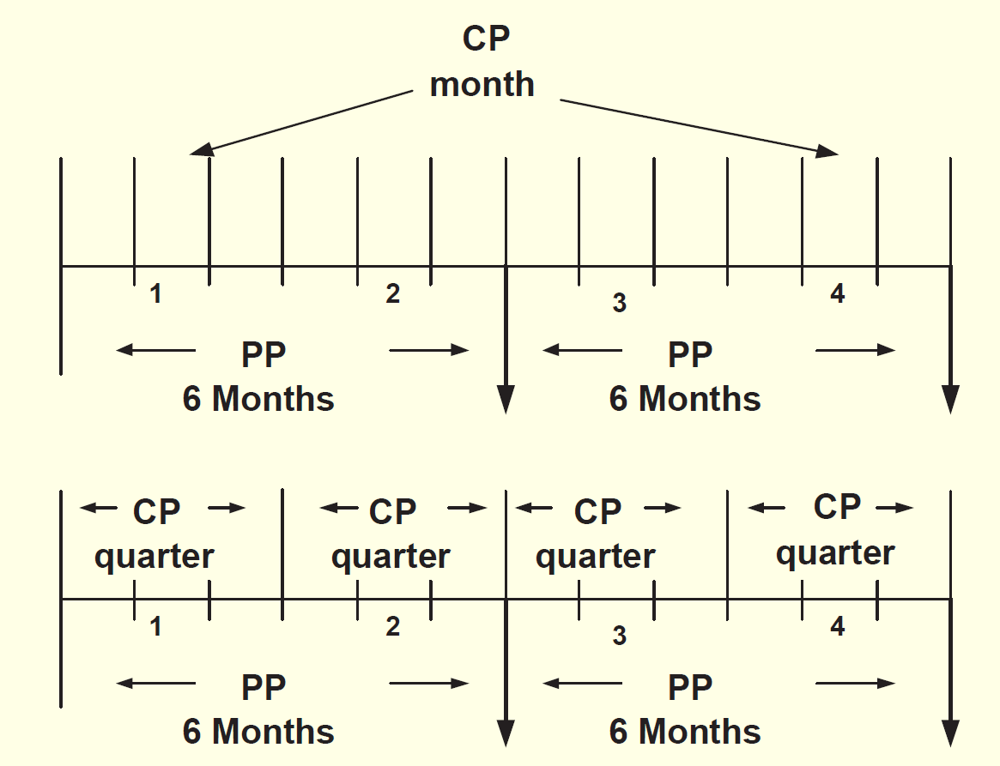

Slide 13
When only single-amount cash flows are involved, there are two correct ways to determine i, n, P/F and F/P factors.
1 Determine the effective interest rate over the compounding period CP, and set n equal to the number of compounding periods between P and F.
2 Determine the effective interest rate over the time period t of the nominal rate, and set n equal to the number of time periods between P and F.

Slide 14
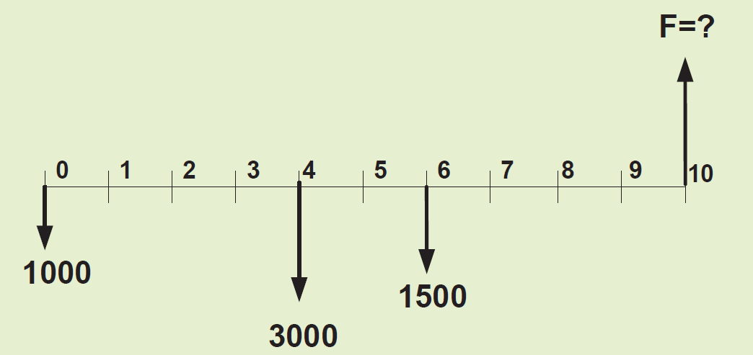
EXAMPLE
Find the future amount equivalence of three cash flows at the end of year 10 at an interest rate of 12% per year, compounded semiannually.

Slide 15
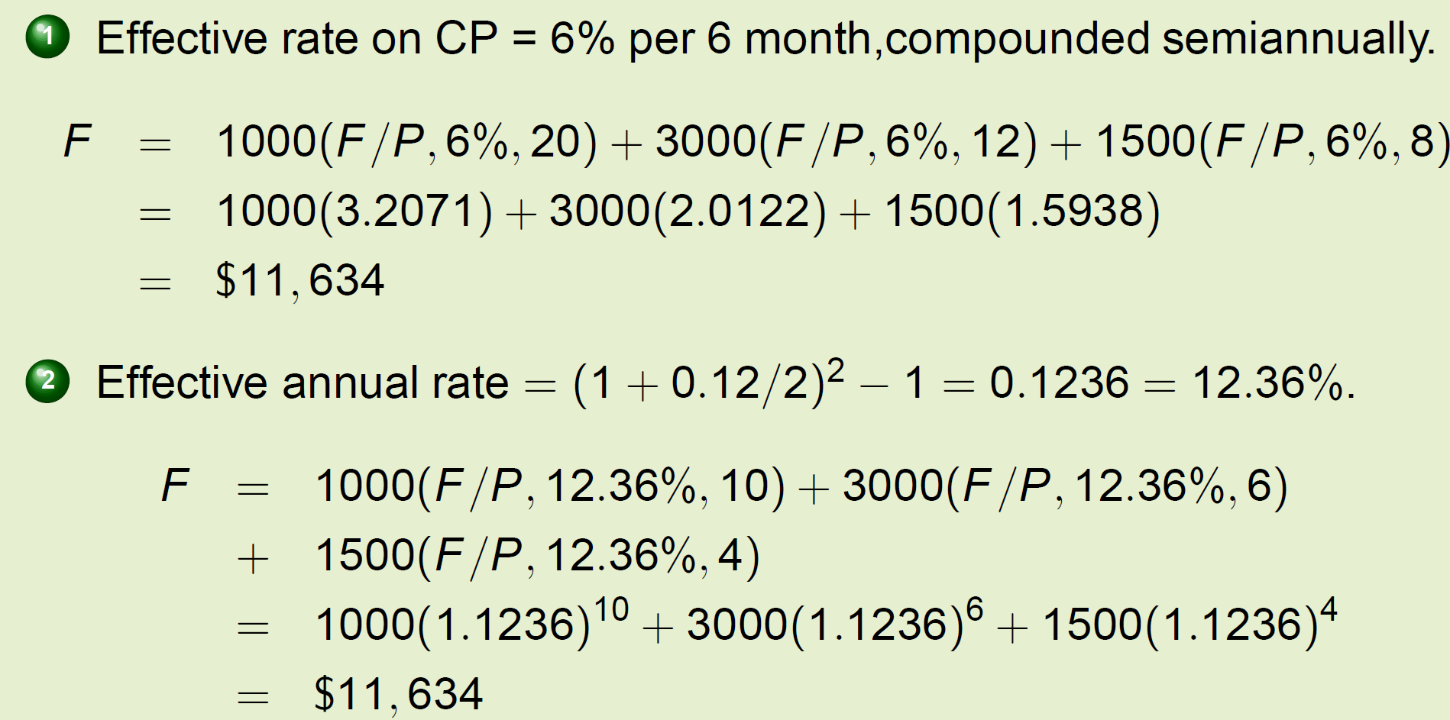

Slide 16
When uniform or gradient series are included in the cash flow sequence, we need to determine the effective interest rate over the frequency of the cash flows.
1) Find the effective i per payment period
2) Determine n as the total number of payment periods.

Slide 17
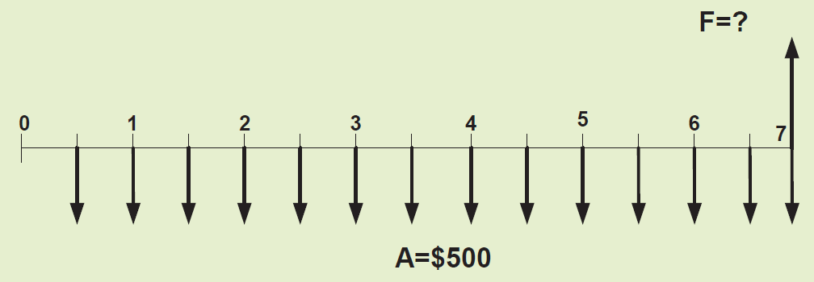
EXAMPLE
For the past 7 years, a quality manager has paid $500 every 6 months for the software maintenance contract of a LAN. What is the equivalent amount after the last payment, if these funds are taken from a pool that has been returning 20% per year, compounded quarterly.

Slide 18
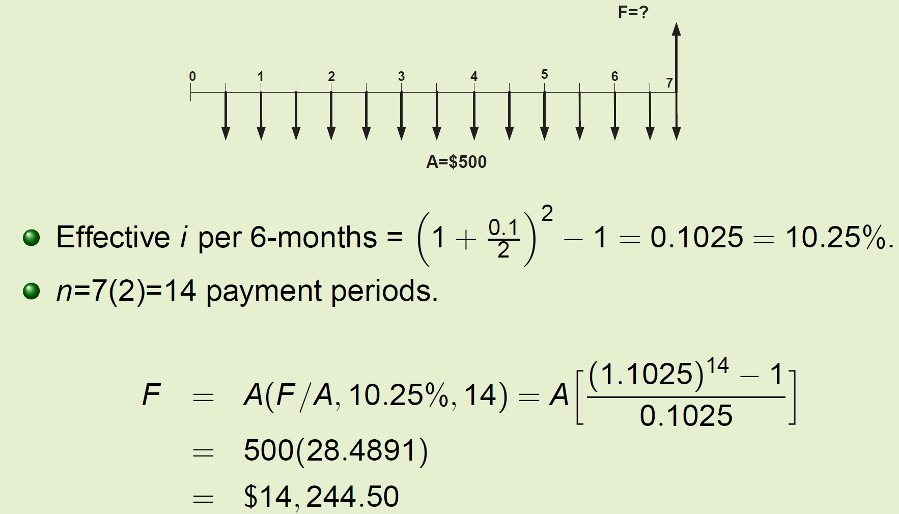

Slide 19
timing mismatch
In real-world projects, cash flows (payments or receipts) often occur between compounding points.
For example, if interest compounds quarterly (every 3 months) but a payment happens every month, then there’s a mismatch — cash flows don’t align with compounding periods.
When this happens, we must decide how to treat money that flows between compounding points.

Slide 20
There are two main approaches:
Option | Description | Effect
With inter-period compounding | Assume money earns interest for the fractional part of the period (e.g., 1.5 months out of 3) | More precise, but complicated
No inter-period compounding (simplified) | Assume no interest is earned (or lost) between compounding points | Easier, commonly used in engineering economics

Slide 21
“No inter-period interest” policy
This is the simplification rule you mentioned. It assumes:
Deposits (outflows) occur at the end of the compounding period (so they don’t start earning until next period).
Withdrawals (inflows) occur at the beginning of the compounding period (so they were available right before interest is calculated).
This convention avoids fractional compounding — it aligns all transactions exactly with compounding points.

Slide 22
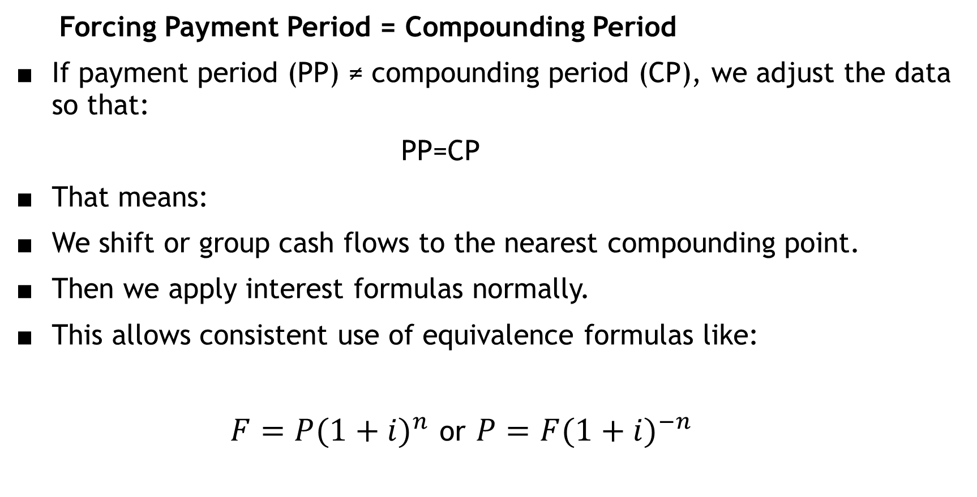
Forcing Payment Period = Compounding Period
If payment period (PP) ≠ compounding period (CP), we adjust the data so that:
PP=CP
That means:
We shift or group cash flows to the nearest compounding point.
Then we apply interest formulas normally.
This allows consistent use of equivalence formulas like:
$F=P{(1+i)}^{n}$ or $P=F{(1+i)}^{−n}$

Slide 23
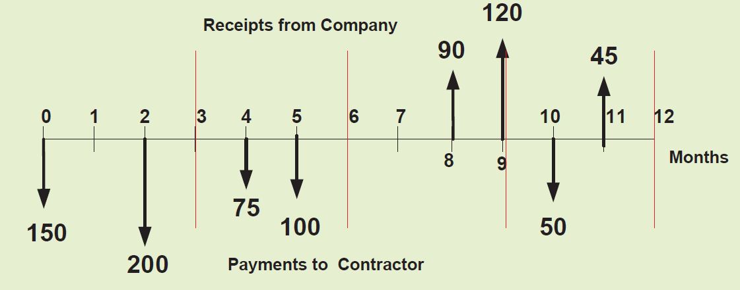
EXAMPLE
The cash flow diagram of a project from the project perspective is given. The applicable interest rate is 12% per year, compounded quarterly. Find the value of future worth, F at the end of year 1.

Slide 24
If your compounding is quarterly but your cash flows are monthly, using the “no inter-period interest” policy means:
Combine or shift cash flows into quarters (months 3, 6, 9, 12).
Treat all receipts/payments within a quarter as if they happen at that quarter’s end (for deposits) or beginning (for withdrawals).
Then calculate future worth using quarterly compounding only.

Slide 25
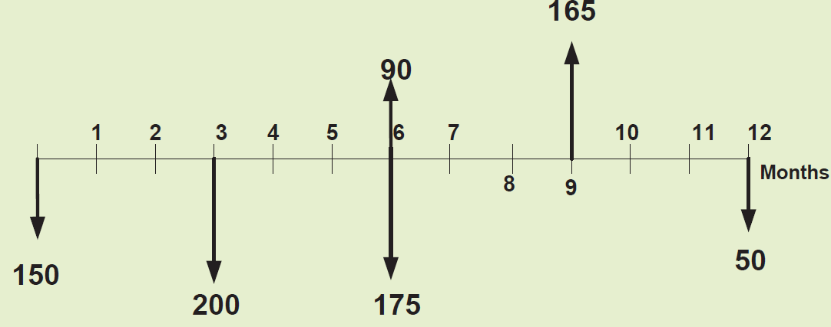

Slide 26
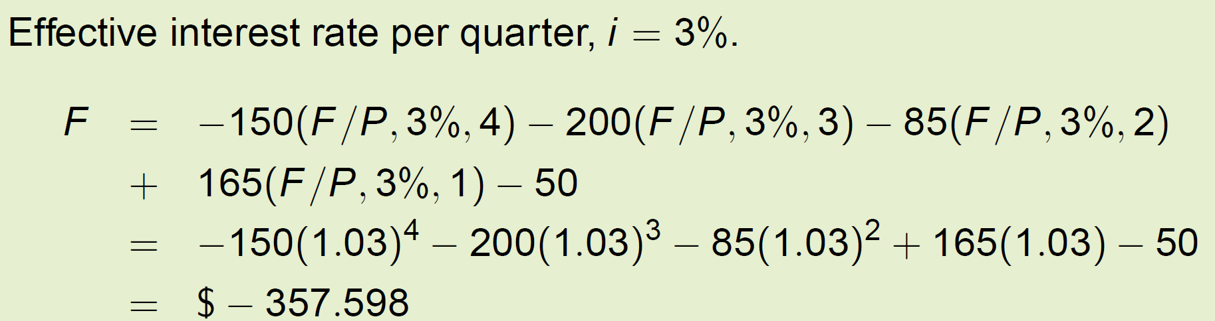

Slide 27
EXAMPLE
An engineering firm bought a new machine for 3 million dollars. They estimate a cost of $200,000 per year for all materials, operating and maintenance costs. The expected life of the machine is 10 years. We want to find the constant revenue requirement for each 6-month period that is necessary to recover the initial investment, interest and annual costs.
Find the semiannual revenue requirement (A) that covers both the initial investment and annual costs for two cases:
1) 8% per year compounded semiannually
2) 8% per year compounded monthly

Slide 28
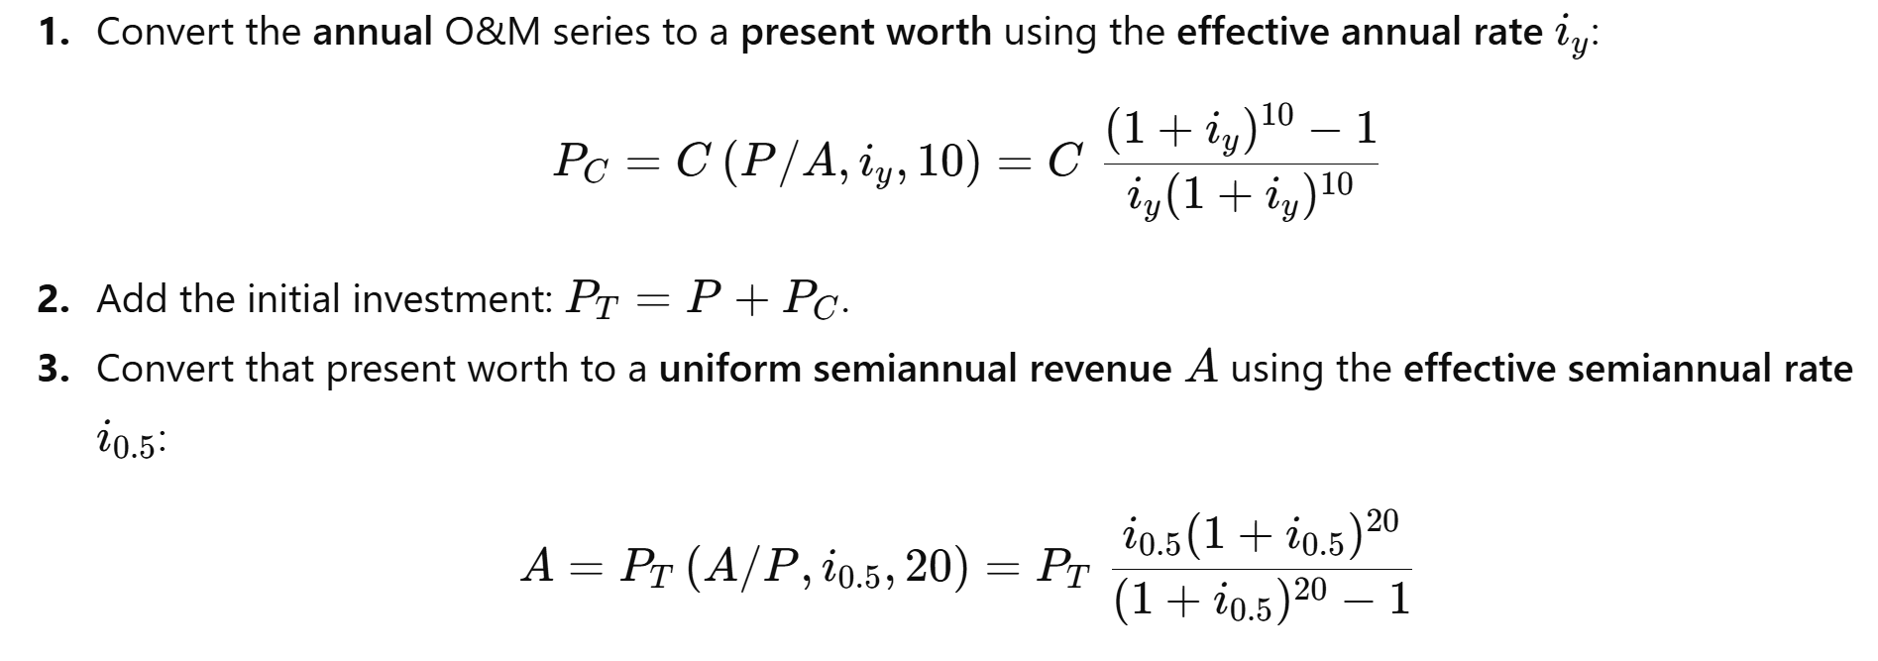

Slide 29
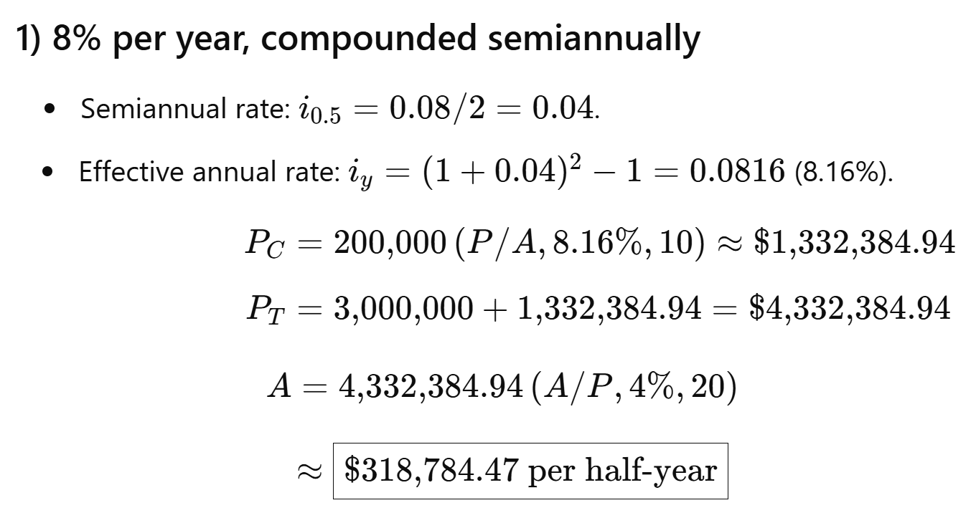

Slide 30
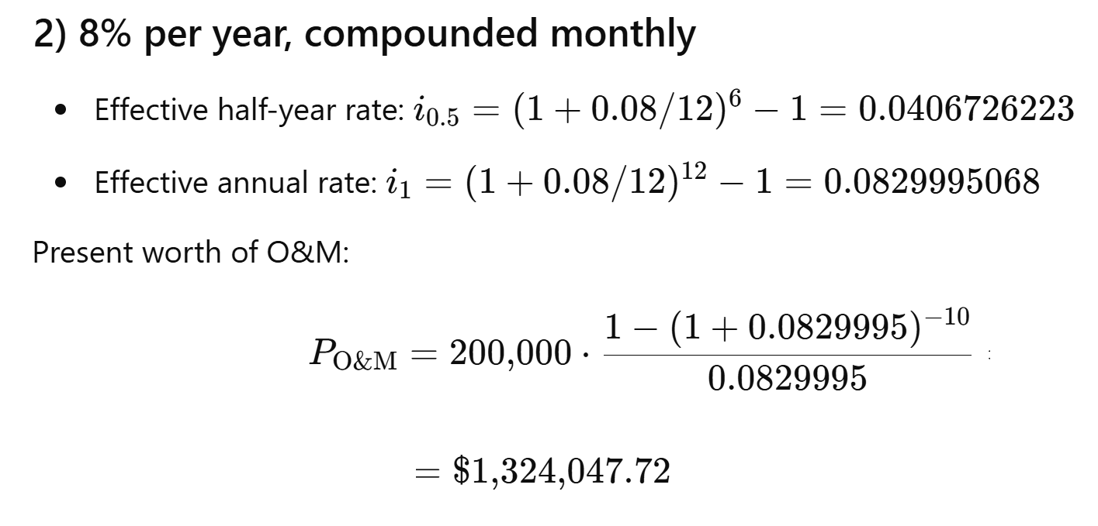

Slide 31
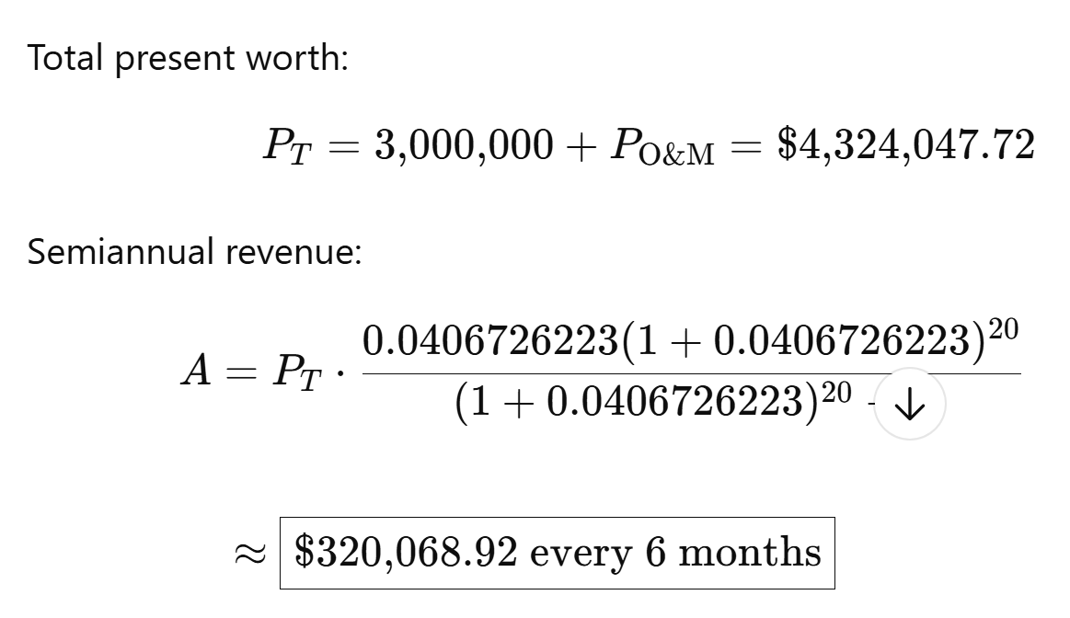
Breakdown:
Capital recovery part: $222,062.01
O&M coverage part: $98,006.90

Slide 32
Equivalence Relations: Single Amounts with PP ≥ CP
When only single-amount cash flows are involved, there are many correct combinations of i and n that can be used to calculate P or F, because of the following two requirements:
(1) i must be expressed as an effective rate, and
(2) the time period of n must be exactly the same as that of i.
These two requirements are fulfilled in two equally correct ways to determine i and n for P∕F and F∕P factors.

Slide 33
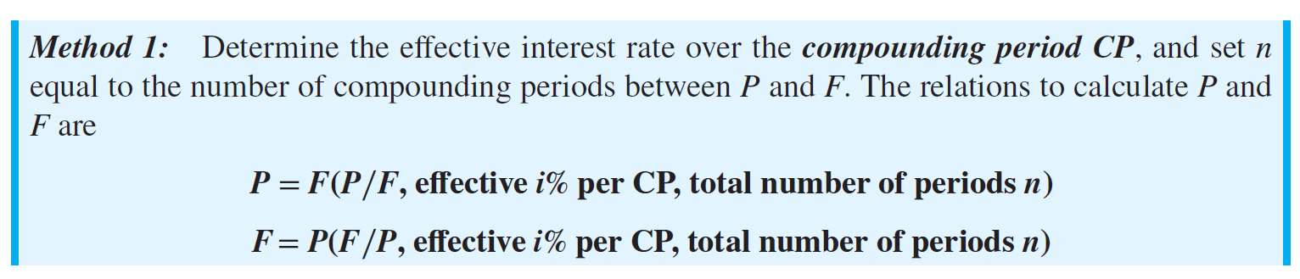
For example, assume that the stated interest rate is a nominal 15% per year, compounded monthly.
Here CP is 1 month. To find P or F over a 2-year span, calculate the effective monthly rate of 15%∕12 = 1.25% and the total months of 2(12) = 24.
Then 1.25% and 24 are used in the P∕F and F∕P factors.

Slide 34
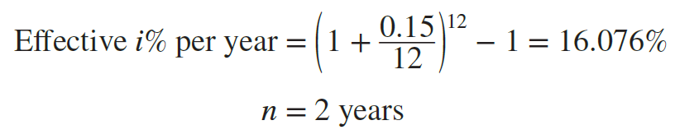
For an interest rate of 15% per year, compounded monthly, and a 2-year time span between P and F, if a time period t of 1 year is used, the effective yearly rate and the n values are
The P∕F factor is the same by both methods: (P∕F,1.25%,24) = 0.7422, and (P∕F,16.076%,2) = 0.7422.

Slide 35
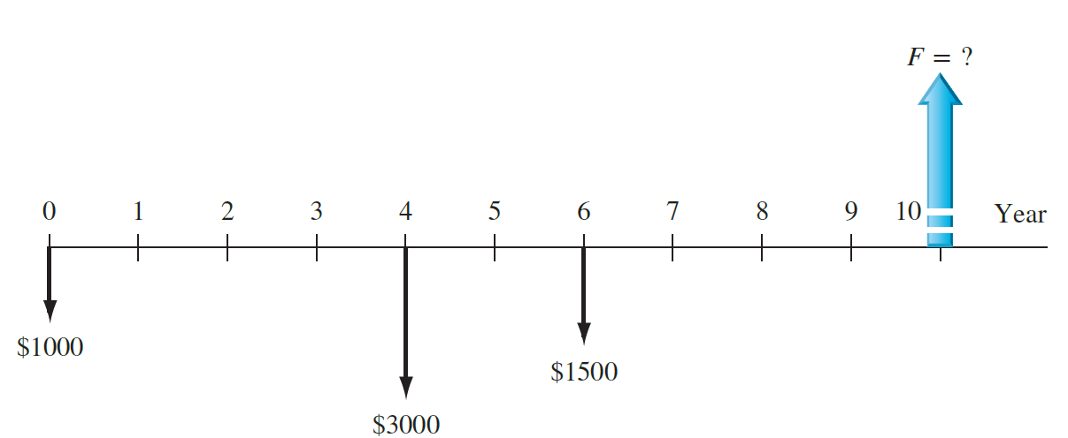
EXAMPLE
Over the past 10 years, Gentrack has placed varying sums of money into a special capital accumulation fund. The company sells compost produced by garbage-to-compost plants in the United States and Vietnam. Figure is the cash flow diagram in $1000 units.
Find the amount in the account now (after 10 years) at an interest rate of 12% per year, compounded semiannually.

Slide 36
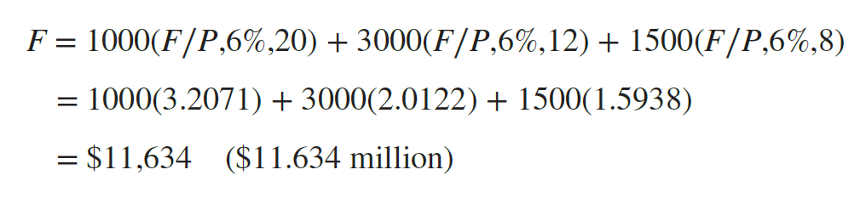
Method 1: Use the semiannual CP to express the effective semiannual rate of 6% per 6-month period. There are n = (2)(number of years) semiannual periods for each cash flow.

Slide 37
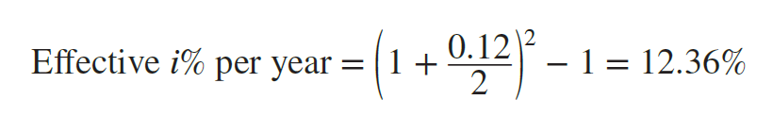
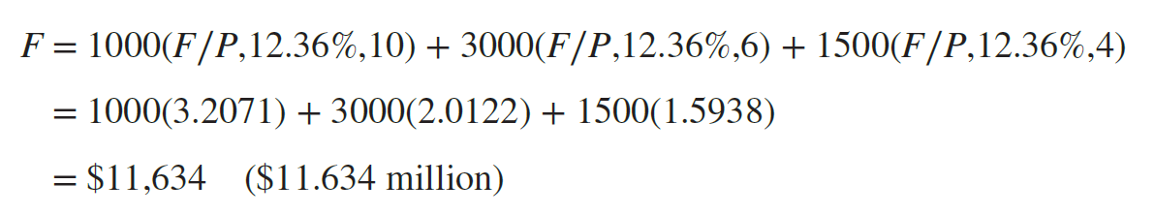
Method 2: Express the effective annual rate, based on semiannual compounding.

Slide 38
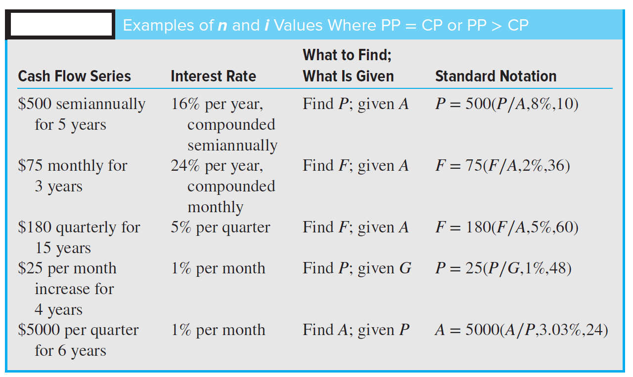

Slide 39
Equivalence Relations: Single Amounts and Series with PP < CP
If a person deposits money each month into a savings account where interest is compounded quarterly, do all the monthly deposits earn interest before the next quarterly compounding time?
If a person's credit card payment is due with interest on the 15th of the month, and if the full payment is made on the 1st, does the financial institution reduce the interest owed, based on early payment? The usual answers are no.
However, if a monthly payment on a $10 million, quarterly compounded, bank loan were made early by a large corporation, the corporate financial officer would likely insist that the bank reduce the amount of interest due, based on early payment.
These are examples of PP < CP.

Slide 40
The timing of cash flow transactions between compounding points introduces the question of how interperiod compounding is handled.
Fundamentally, there are two policies, one of which must be applied: interperiod cash flows earn no interest or they earn compound interest.
For a no-interperiod-interest policy, negative cash flows (deposits or payments, depending on the perspective used for cash flows) are all regarded as made at the end of the compounding period, and positive cash flows (receipts or withdrawals) are all regarded as made at the beginning.
As an illustration, when interest is compounded quarterly, all monthly deposits are moved to the end of the quarter (no interperiod interest is earned) and all withdrawals are moved to the beginning (no interest is paid for the entire quarter).

Slide 41
EXAMPLE
Last year, AllStar Venture Capital invested in a new company called Clean Air Now (CAN), which makes filtration systems for coal power plants. AllStar paid money to CAN during the first year and also received some unexpected payments back. The annual interest rate is 12% compounded quarterly, and AllStar does not use interperiod interest (interest is only applied at quarter ends).
Based on the cash flow diagram (in $1,000 units) showing these payments and receipts, how much money has AllStar lost (is “in the red”) by the end of the first year?

Slide 42
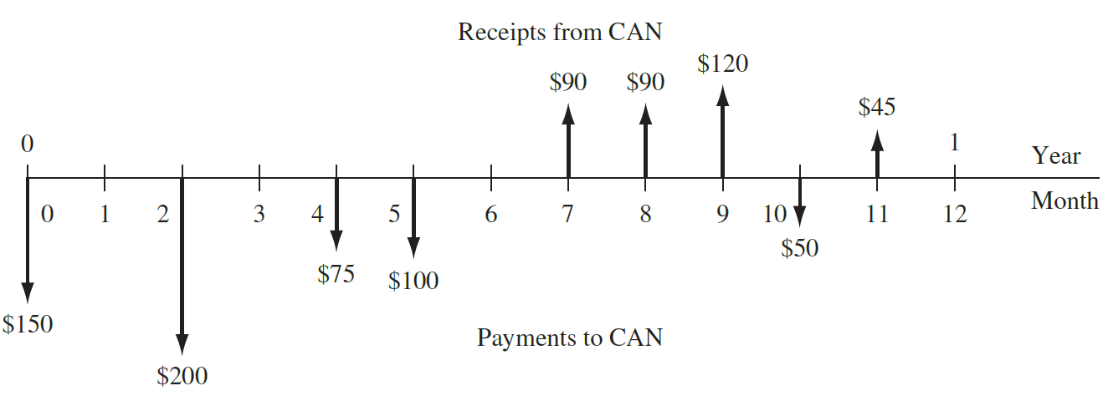
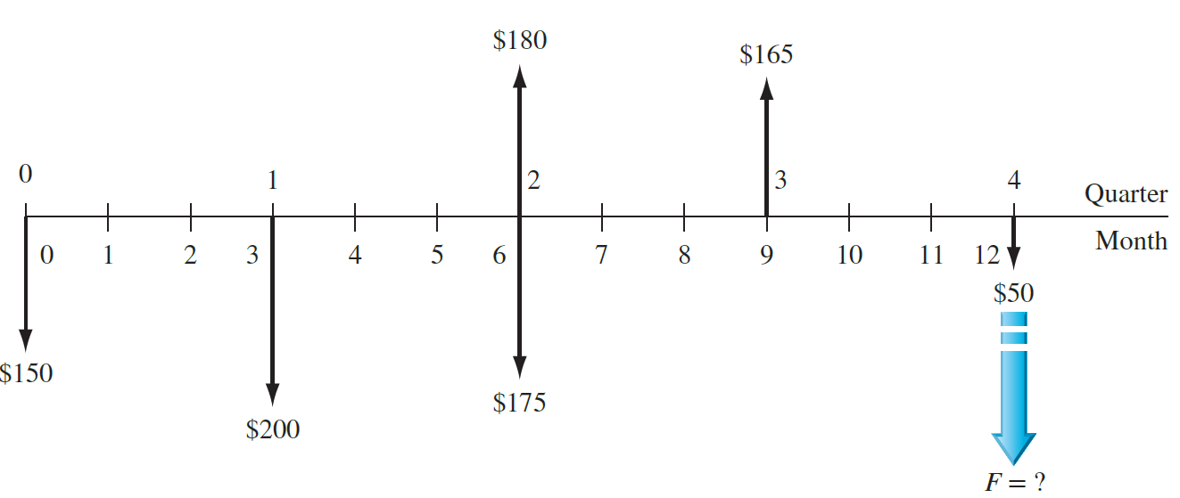

Slide 43
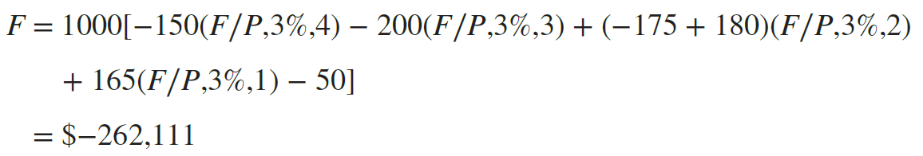
All negative cash flows (payments to CAN) are moved to the end of the respective quarter, and all positive cash flows (receipts) are moved to the beginning of the respective quarter. Calculate the F value at 12%∕4 = 3% per quarter.
AllStar has a net investment of $262,111 in CAN at the end of the year.

Slide 44
Effective Interest Rate for Continuous Compounding
If we allow compounding to occur more and more frequently, the compounding period becomes shorter and shorter and m, the number of compounding periods per payment period, increases.
Continuous compounding is present when the duration of CP, the compounding period, Becomes infinitely small and m, the number of times interest is compounded per period, becomes infinite. Businesses with large numbers of cash flows each day consider the interest to be continuously compounded for all transactions.
As m approaches infinity, the effective interest rate must be written in a new form.

Slide 45
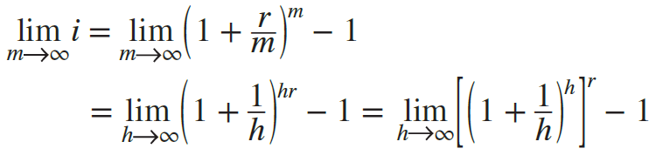

This equation is used to compute the effective continuous interest rate, when the time periods on i and r are the same.

Slide 46
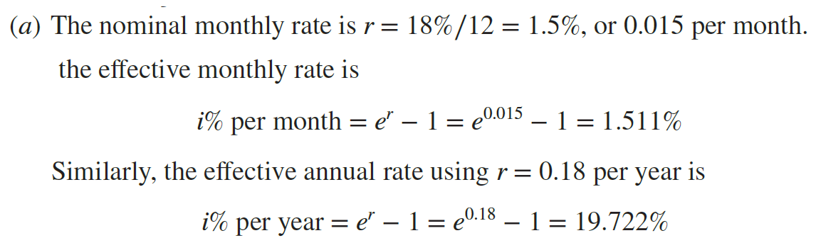
EXAMPLE
(a) For an interest rate of 18% per year, compounded continuously, calculate the effective monthly and annual interest rates.
(b) An investor requires an effective return of at least 15%. What is the minimum annual nominal rate that is acceptable for continuous compounding?

Slide 47
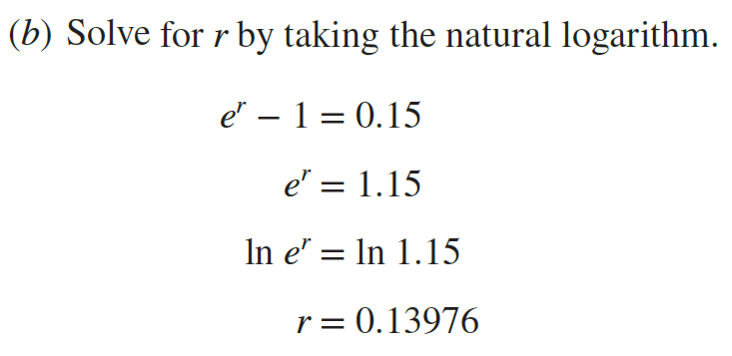
Therefore, a rate of 13.976% per year, compounded continuously, will generate an effective 15% per year return.
The general formula to find the nominal rate, given the effective continuous rate i, is r = ln(1 + i).

